Slide 1
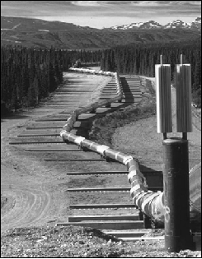
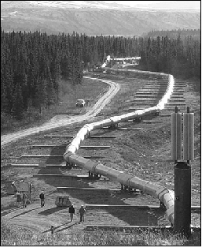
Fault Displacement Hazard Assessment with a focus on how pre-rupture fault mapping will help inform models
(before)
(after)
Trans-Alaska Pipeline before and after the
2002 M 7.9 Denali earthquake
Sorensen and Meyer (2003)
Steve Thompson, Lettis Consultants International (LCI)
August 27, 2020, Mapping Tectonic Faults from Geomorphology

Slide 2
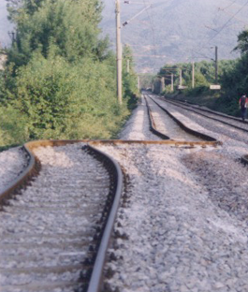
Outline
Mitigating fault rupture hazard
Deterministic and probabilistic hazard analysis
PFDHA methodology (using Petersen et al., 2011)
Role of pre-rupture fault mapping
Questions/Discussion
1999 Turkey

Slide 3
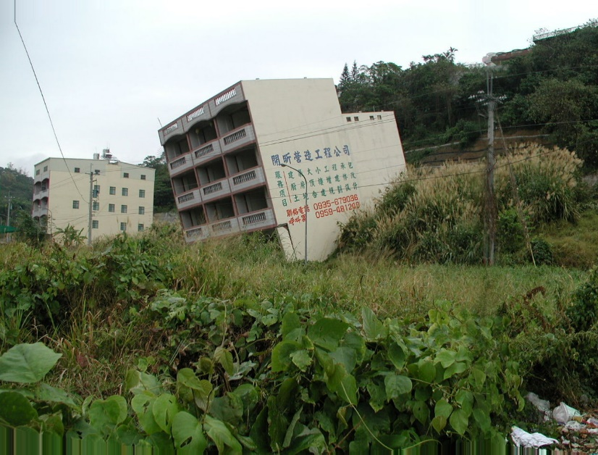
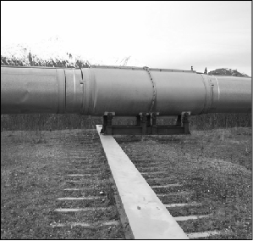
Mitigating Fault Rupture Hazard
What is “safe enough”? Cost versus safety
Should we be designing infrastructure that is 100% seismically safe?
Society discussion
Mitigation options:
avoidance
design
no mitigation (accept risk)
Example – California Alquist-Priolo Act following 1971 San Fernando EQ
Avoid faults that are “sufficiently active and well defined”
1999 Chi Chi, Taiwan earthquake rupture across apartment
TAPS bent over skid after earthquake; Sorensen and Meyer (2003)

Slide 4
Deterministic and Probabilistic Hazard Analysis
Deterministic hazard analysis – “worst case” scenario earthquake;
no consideration of the annual probability of the scenario occurring
“safe enough” is reflected in the percentile
Probabilistic hazard analysis – all plausible scenarios and all outcomes are considered
Rates of scenarios important
Hazard is a summation from all earthquakes and all sources
“safe enough” is reflected in the annual frequency of exceedance (or return period)

Slide 5
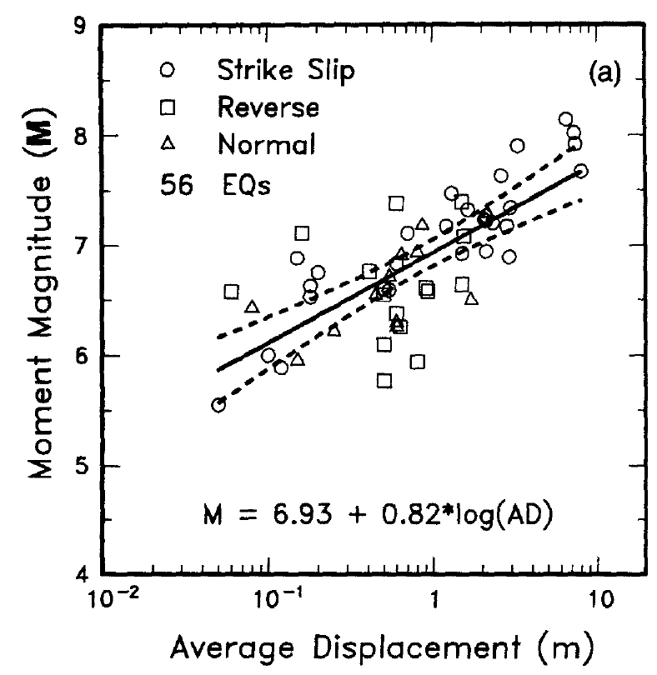
PFDHA – Basic Calculation of a Hazard Curve
Example
Scenario = M 7.0
WC94 log₁₀(D)-M
Log₁₀ sigma = 0.3
1000 yr RI
$$AD= {10}^{(0.69∗M−4.80 ±0.36)}$$
Notes:
Plot is from Wells and Coppersmith (1994). Other datasets and regressions are available to help predict displacement from earthquake magnitude. The Log10 sigma value used in this example is smaller than what the data show and is for demonstration purposes only.
The PDF is on a semi-log plot, and shows the average value and the uncertainty in the average given the lognormal relation and lognormal sigma.
The CDF is the same information on a different plot.

Slide 6
PFDHA – Basic Calculation of a Hazard Curve
Mean Rate = 1/1000 yr (1.E-03 yr⁻¹)
$$P_{x,y}\left(D≥D_{0} | {Rup}_{P}\right)$$
Semi-Log Plots
Log-Log Plots
Notes:
A single scenario hazard curve is simply the same CCDF, plotted on a log-log scale, and then is scaled vertically such that the exceedance probability of 1 (the lower tail of the PDF) is set to the mean rate of the event (the inverse of the mean recurrence interval). In the example, 1E-04 annual exceedance probability (or frequency) represents the 10% exceedance probability of the CCDF.

Slide 7
PFDHA – Input to a Probabilistic Analysis
Definitions:
Epistemic uncertainty = model uncertainty or model alternative
Aleatory uncertainty = natural variability
Fundamental Needs:
Mean displacement (± epistemic uncertainty in the mean)
2.4 m
2.4 m
2.4 m
1.1 m
1.1 m
0.5 m
0.5 m
Notes:
Understanding of epistemic (model) uncertainty and aleatory (natural) variability is key to understanding how the hazard curve is constructed, and how a logic tree is used to calculate results. In short, a PFDHA requires a few very specific pieces of information.

Slide 8
PFDHA – Input to a Probabilistic Analysis
Definitions:
Epistemic uncertainty = model uncertainty or model alternative
Aleatory uncertainty = natural variability
Fundamental Needs:
Mean displacement (± epistemic uncertainty in the mean)
Natural (aleatory) variability about the mean (± epistemic uncertainty in the variability)
2.4 m
1.1 m
0.5 m
0.4
0.4
0.4
0.3
0.3
0.2
0.2
Notes:
Understanding of epistemic (model) uncertainty and aleatory (natural) variability is key to understanding how the hazard curve is constructed, and how a logic tree is used to calculate results. In short, a PFDHA requires a few very specific pieces of information.

Slide 9
PFDHA – Input to a Probabilistic Analysis
Definitions:
Epistemic uncertainty = model uncertainty or model alternative
Aleatory uncertainty = natural variability
Fundamental Needs:
Mean displacement (± epistemic uncertainty in the mean)
Natural (aleatory) variability about the mean (± epistemic uncertainty in the variability)
Mean occurrence rate (± epistemic uncertainty in the mean)
2.4 m
1.1 m
0.5 m
0.4
0.3
0.2
1/500
1/500
1/500
1/1,000
1/1,000
1/2,000
1/2,000
Notes:
Understanding of epistemic (model) uncertainty and aleatory (natural) variability is key to understanding how the hazard curve is constructed, and how a logic tree is used to calculate results. In short, a PFDHA requires a few very specific pieces of information.

Slide 10
Logic Tree and Hazard Curves
Mean
Displacement
Aleatory
Variability
(Sigma)
Mean Rate of
Occurrence
(1/yr)
2.4 m
0.4
1/500
1.1 m
0.3
1/1,000
0.5 m
0.2
1/2,000
Curve Width
Curve
Steepness
Curve
Height

Slide 11
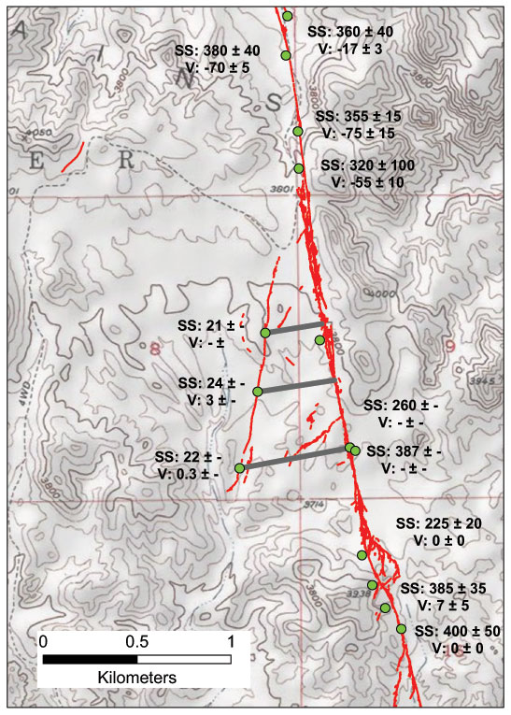
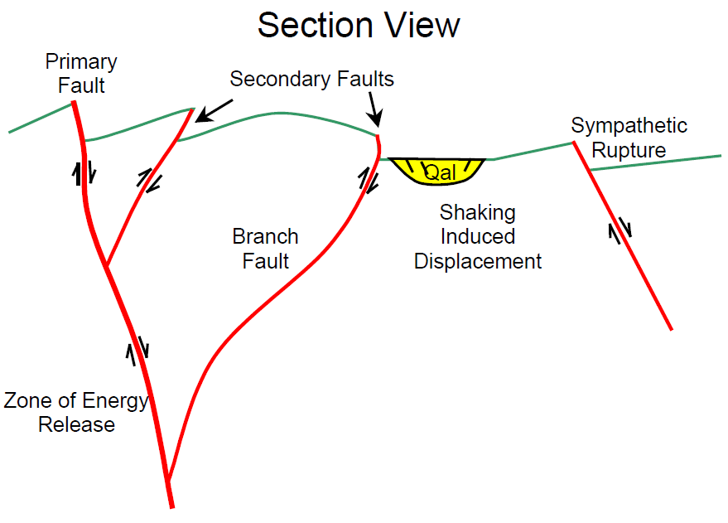
Terminology
Principal fault; principal displacement (aka primary)
Secondary fault; secondary or distributed displacement
Other: distributed deformation; triggered (sympathetic) slip, …
(not fault displacement)
Petersen et al. (2011), Figure S3.

Slide 12
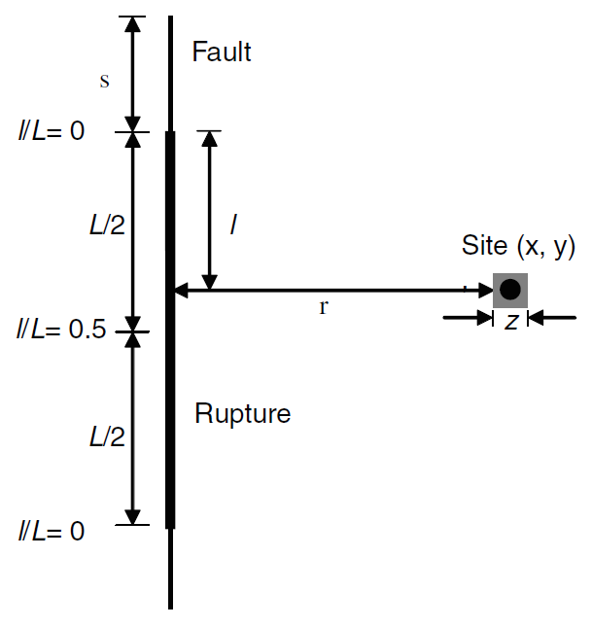
Petersen et al. (2011) PFDHA formulation
$$λ_{xyz}(D>D_{0})=α(m_{min})\int_{m,s}{f_{M,S}\left(m,s\right)}P[sr≠0|sof,m]$$
$×\int_{r}{f_{R}\left(r\right) P_{xyz}[D≠0|z,r,sr≠0]}P_{xy}[D>D_{0}|{sof,m,L}^{∗},D≠0]drdmds$
Terms:
Earthquake location-magnitude-recurrence distribution
Conditional probability of surface rupture
Conditional probability of displacement occurring at the site of interest
Displacement exceedance
Petersen et al. (2011), Figure 1.

Slide 13
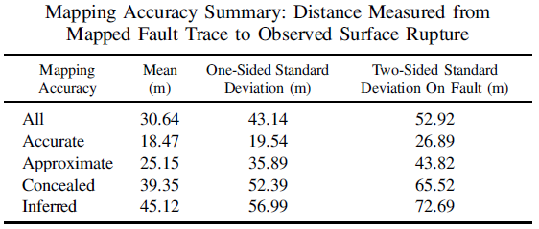
Conditional probability of displacement occurrence
$\int_{r}{f_{R}\left(r\right) dr}$ = Principal fault rupture location uncertainty
simple
complex
Petersen et al. (2011), Figure 3.
1999 Hector Mine, CA rupture
Petersen et al. (2011), Figure 3.
Petersen et al. (2011), Table 2.

Slide 14
Fault location using Q-faults database
(error versus uncertainty)
LiDAR source: Hudnut et al., (2020) Airborne Lidar and Electro-Optical Imagery along Surface Ruptures of the 2019 Ridgecrest Earthquake Sequence, Southern California. Seismological Research Letters, 91 (4). pp. 2096-2107. ISSN 0895-0695.

Slide 15
(expectation for site-specific hazard study)
Fault location using site-specific geomorphic mapping
Pre-rupture mapping source: Philibosian et al., Evidence of Previous Faulting along the 2019 Ridgecrest, California, Earthquake Ruptures. Bulletin of the Seismological Society of America (2020) 110 (4): 1427–1456

Slide 16
Rupture location uncertainty assessment
This is our goal!

Slide 17
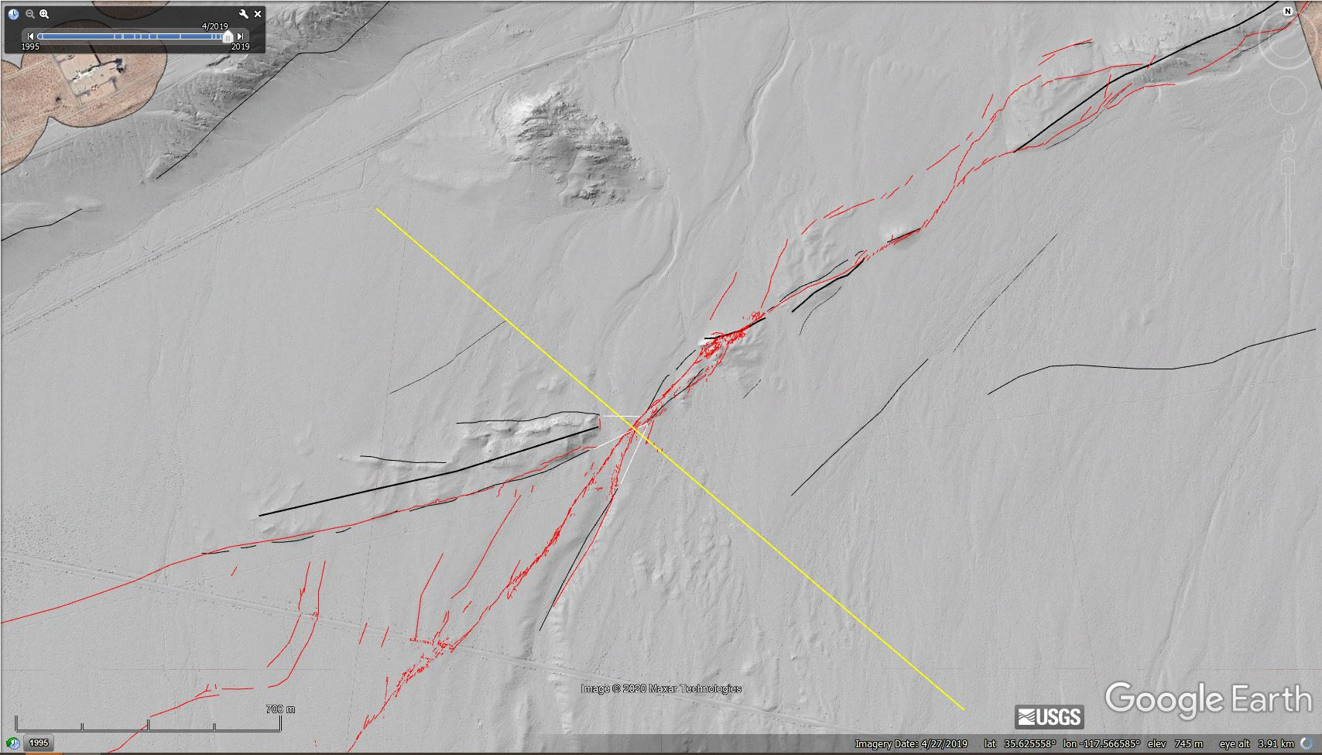
Conditional probability of displacement occurrence
Why might surface rupture not occur on a mapped fault?
Principal faulting
Due to gaps in rupture (an extension of P[sr≠0])
Due to epistemic uncertainty in fault location
Due to aleatory variability in rupture location
Information needed to update/improve models
More high-quality, detailed maps of surface-fault ruptures (no errors)
Detailed pre-rupture fault maps showing geologic and geomorphic evidence of faulting
Paleoseismic (subsurface) data
Better data will lead to more explanatory variables, more robust statistics, and better models

Slide 18
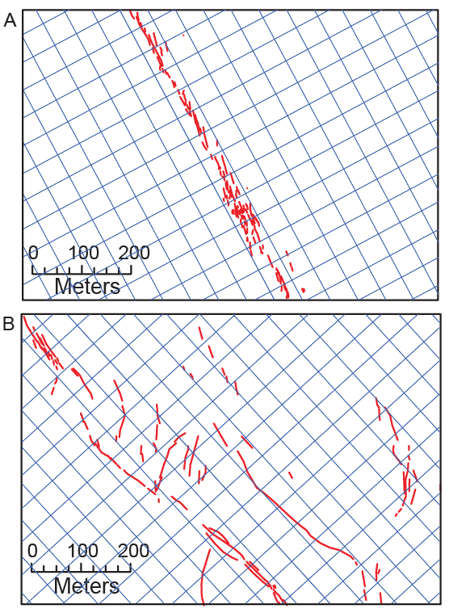
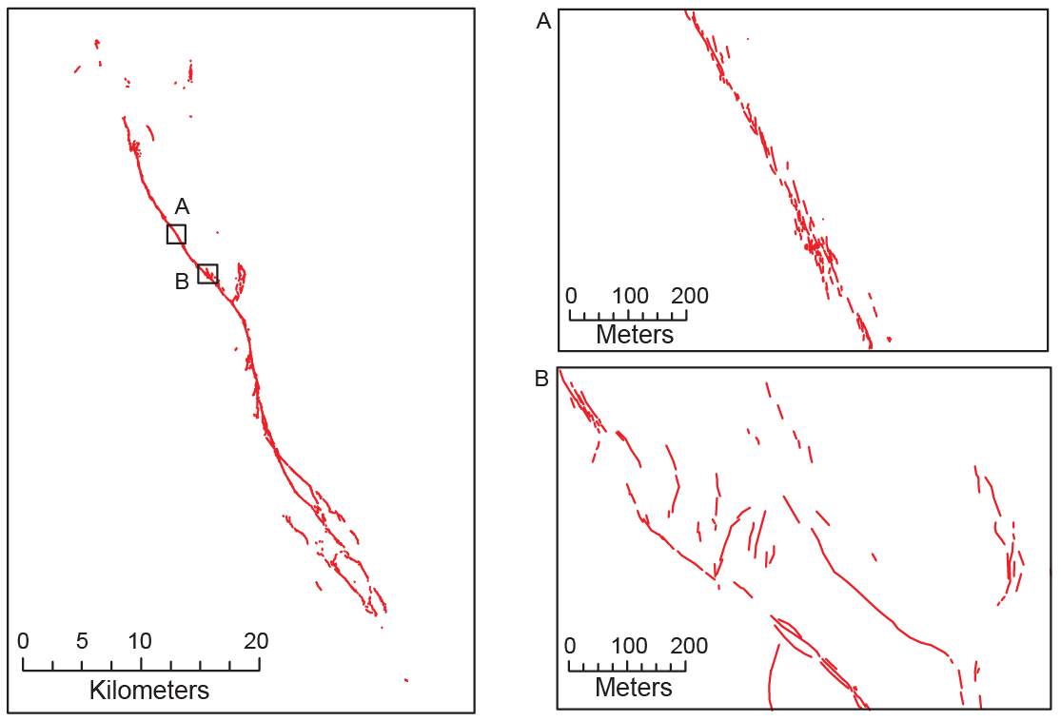
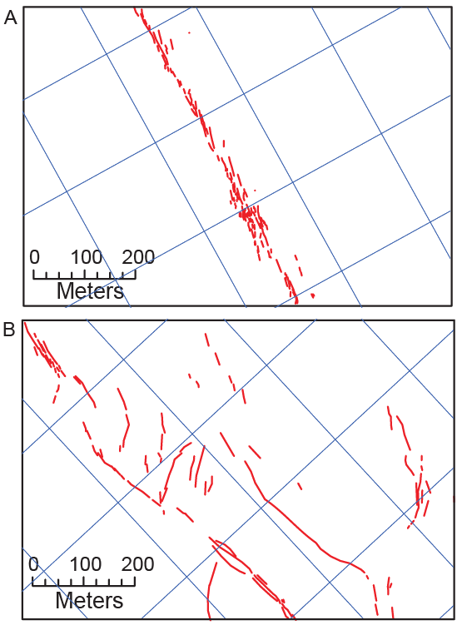
Conditional probability of displacement occurrence
$P[d≠0|r,z,sr≠0]$ Distributed displacement conditional probability
Z = 200 m
1999 Hector Mine, CA rupture
Z = 50 m
Evaluation of different cell dimensions z
Grid-counting approach
No pre-rupture mapping involved
Petersen et al. (2011), Figure 3.

Slide 19
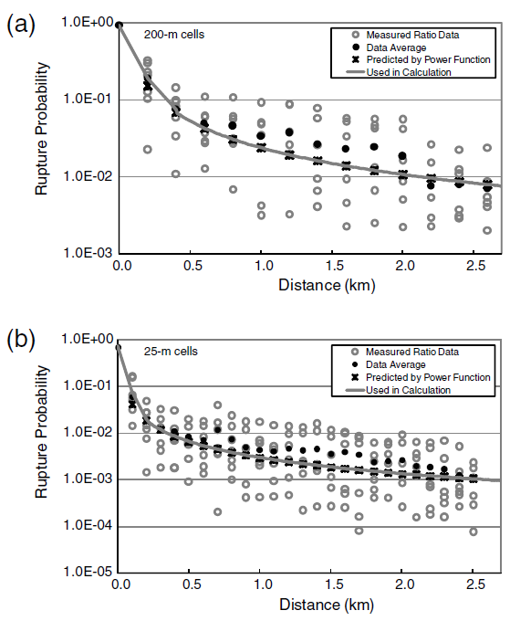
Conditional probability of displacement occurrence
$P[d≠0|r,z,sr≠0]$ = Distributed displacement conditional probability
Evaluation of different cell dimensions z
No pre-rupture mapping involved
1999 Hector Mine, CA rupture
Petersen et al. (2011)
Petersen et al. (2011), Figure 8.

Slide 20
Distributed rupture probability with pre-rupture mapping

Slide 21
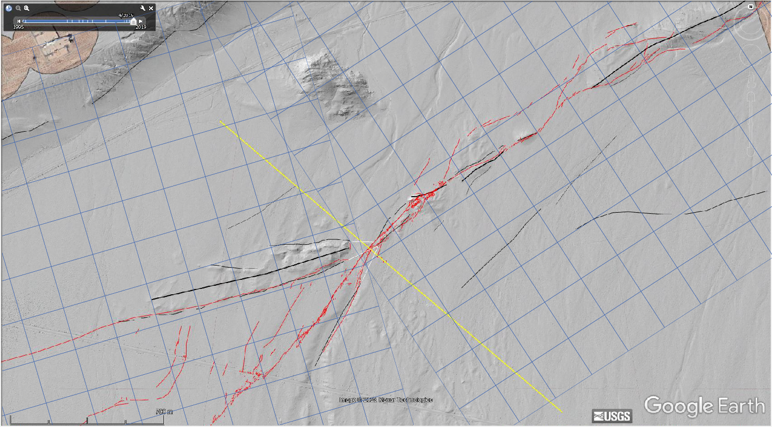
$P[d≠0|r,z,flt,...]$ -- pre-rupture mapping offers more, useful tests)

Slide 22
Summary / Conclusions
Hazard mitigation – what is “safe enough”?
Types of facilities concerned with fault displacement hazard
Lifelines: water pipelines, oil and gas pipelines, bridges and tunnels
Discrete facilities: dams, nuclear installations, water treatment plants, buildings
Approaches to hazard analysis:
Deterministic (DFDHA)
Probabilistic (PFDHA)
Current PFDHA elements:
Earthquake location-magnitude-recurrence relationship
Conditional probability of surface rupture
Conditional probability of rupture at a site
Displacement exceedance equations
Primary displacement and secondary (distributed) displacement

Slide 23
Summary / Conclusions (cont.)
Pre-rupture fault mapping importance:
Improvements over current standard of practice
Challenge an existing heuristic that a good fault map = rupture map
More quantitative assessments of fault location uncertainty
PFDHA - Conditional probability of rupture model improvements:
Better models with more explanatory variables
We can leverage the types of data and information that are typically collected
Better ability to capture epistemic uncertainty, and separate it from aleatory uncertainty
Guidance and Hopes:
Prioritize high-quality mapping: minimize errors, clear documentation
Prioritize individual work, with guidance from instructors: we value differences in interpretations
The “correct” answer IS NOT the actual rupture: cheating will compromise the project.

Slide 24
Other/extra

Slide 25
Questions from students
How is this data applied and implemented to inform earthquake hazards and policy?
What variables influence the distance of displacement from the fault?
How were strike-slip fault data compiled?
Is it standard in this field to constantly update models as earthquakes occur, or does it occur periodically once there is a substantial dataset?
How do these models work in areas with inactive and active fault traces in the same region?
How do these models work for faults that have controversy regarding their status (active or not active)?
How would you take into account variations of displacement along the fault trace into this? In this instance, could you segment the fault and analyze each section based on high vs. low displacement?
Why wouldn’t these methods work in areas with some oblique slip or lower dipping slip?

Slide 26
Questions from students (cont.)
They talk about the distance from the principal fault to the surface rupture. Wouldn’t the surface rupture be the principal fault, and if not, how do they know? Is it an additional surface rupture? Aren’t these additional ruptures a type of sympathetic structures?
With the concealed or interpreted structures showing such a large gap distance from actual structures, would that indicate that perhaps the fault has moved or transferred to a different structure? Or just straight up was interpreted erroneously?
Are all three model types applied to the fault if we don’t know what type it is likely to be? Is this the industry standard?
Looking at figure 6. Is there really any meaningful difference between the different model applications?
What equation/methodology is used to determine the hazard of an area that could be prone to earthquakes, yet has not experienced one yet to warrant field investigation? (“Probability of Ground Rupture for Distributed Faulting (Off-Fault), 818).
Can this assessment be applied to earthquakes with smaller magnitudes? Or is the hazard assessment less likely to be conducted?
Based on the information concluded in this paper, do higher-magnitude strike-slip faults pose more of a general hazard than normal faults like those studied in Stepp et al. (2001) and Youngs et al. (2003)?
In what ways should the aleatory variability and epistemic uncertainty be categorized to reduce error in the displacement hazard analysis?

Slide 27
Questions from students (cont.)
Why are neotectonics not included in the methods of this paper? At what point in a fault assessment are neotectonics factored into the analysis?
Is there a correlation between the aleatory uncertainties found in more current fault analysis and the conclusions within Paleoseismology?
How do triggered displacements compare to original earthquake displacements?
How do geologists overcome the “complicated sections” where discrete faults traces are more difficult to recognize?
Will I need to know any of the equations brought up in this paper when doing my project?
The analysis did not account for nontectonic displacement. Is this common to leave out when considering fault systems?
How will we account for the inaccuracies that come with a 1:24,000 scale map?
Why do they recommend using a 1:24,000 scale map if it is known to have possible inaccuracies of up to 40ft? would this just be for large area maps?

Slide 28
Conditional probability of rupture – Secondary faulting
Questions we have in hazard assessment (partial list):
What are criteria for geomorphic mapping of “secondary” faults
Do all or some mappable secondary faults rupture during earthquakes?
Are any geomorphic features better or worse predictors of rupture than others? E.g., scarps versus linear drainages.
How should models be adjusted to account for the presence of a “secondary” fault through a site? Any difference in adjustments if faults are identified based on geomorphic expression versus based on geologic observations? What adjustments to models are warranted if there is geomorphic or geologic evidence for no faulting?
Will conditional probability models that incorporate pre-rupture mapping of secondary features perform better than models based only on post-rupture mapping?

